Slide 1
Taking the Scary out of Scala
Anna-Maria Wykes
Data Engineering & Cloud Consultant

Slide 2

Who am I?
Senior Advancing Analytics Consultant
Data Engineering & Cloud
Over 14 years’ experience working in Software & Data Engineering, most recently working with Scala, Kafka and various cloud tech
BSc in Multimedia Computing & Business, and a HND in Visual Communication
@annawykes
anna-maria-wykes-31939454

Slide 3
What makes me tick?
Passion for Data and strive to bring the worlds of Software Development and Data Science closer together.
Helped to organize/run local Code Clubs
Organize and volunteer at local events
Other areas of interest include UX, and Agile methodologies

Slide 4
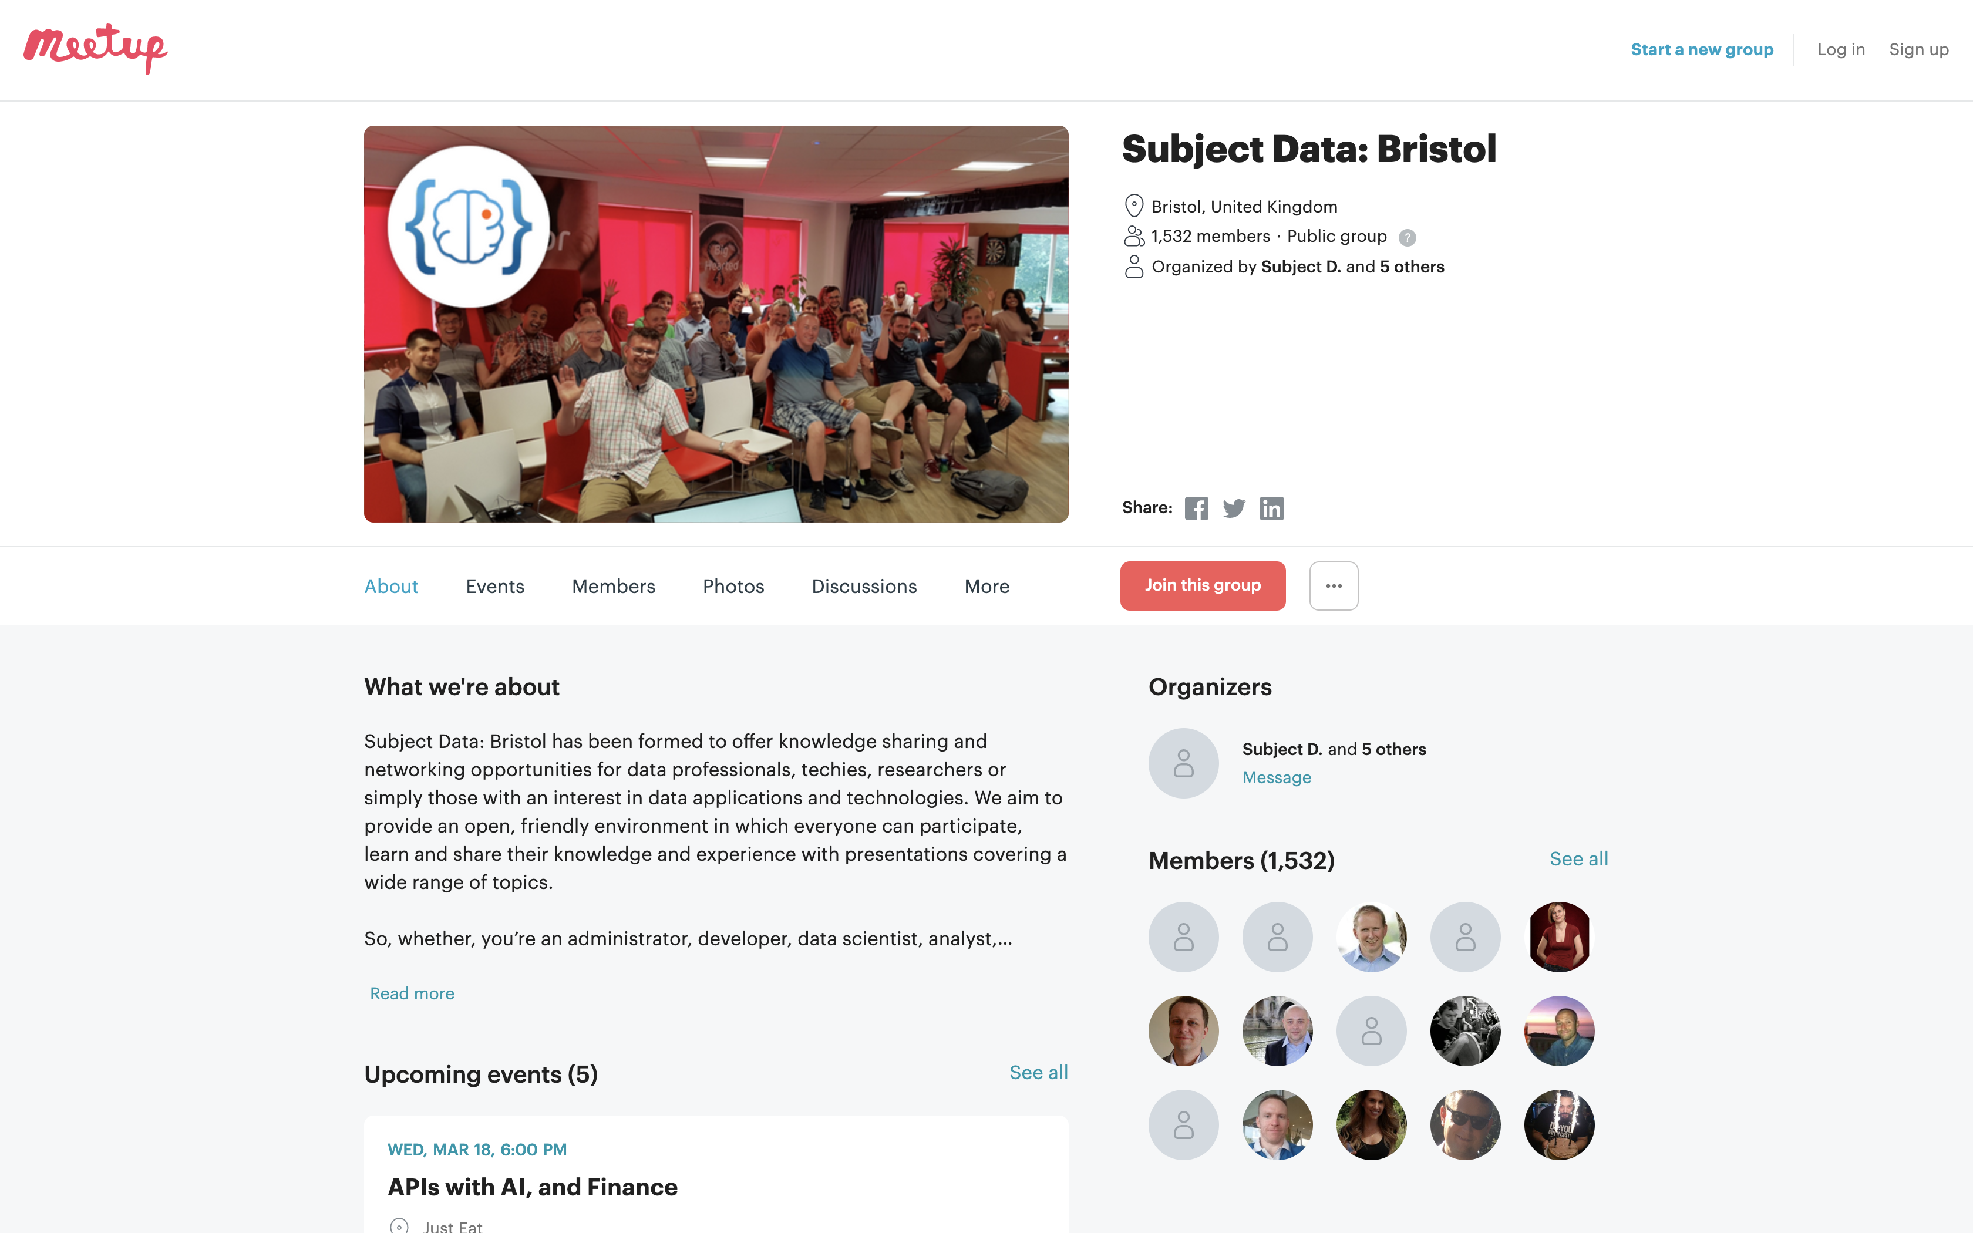
MEETups and Community Groups

Slide 5

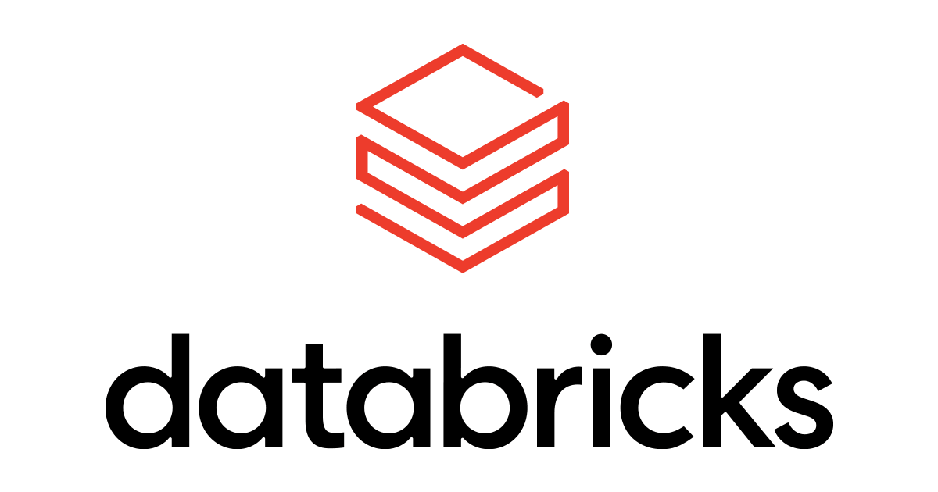

What are we going to do………

Slide 6

WHY?
Notes:
Spark & Databricks is written in Scala under the hood
It is inevitable you will have to work with Scala at some point
Common packages written in Scala

Slide 8

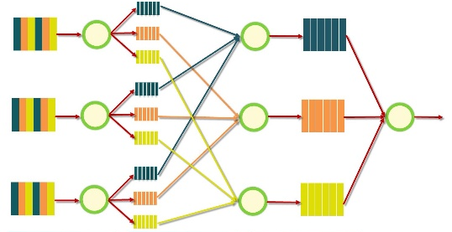

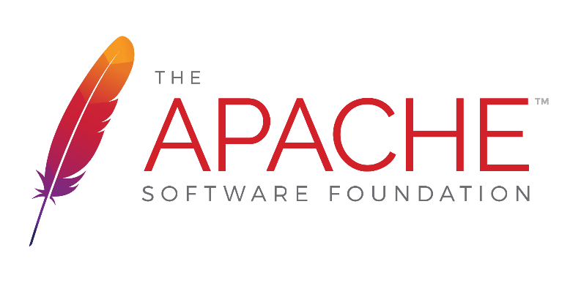

Google MapReduce Papers
2004
Google File System Papers Released
2006
2003
Databricks blurb
Apache Hadoop project created
Matei Zaharia starts Spark project
Project donated to Apache Foundation
Databricks founded by Matei
2010
2013
2013
Notes:
1 - GFS Released. Google were facing a problem in that they simply couldn’t find disks big enough and fast enough to store all the data they had. They came up with a master plan to “chunk” files up and spread it across multiple disks! This became HDFS - the tech that’s inside blob storage, Amazon S3 buckets and Data Lake Store
2 - Now that data was nicely distributed, they still had the problem that a single computer had to read all of those distributed chunks. They had essentially removed the I/O bottleneck and replaced it with a compute one! Google came out with the MapReduce papers which essentially did the same distribution but for a compute - taking a query/transformation/compute task, breaking it up into different parts and giving it to lots of different servers, each to perform their own chunk.
3 - Both MapReduce, HDFS and a bunch of other stuff was donated to the Apache foundation and became the open sourced project known as Apache Hadoop. There’s a WHOLE TON of different projects, languages, framesworks etc that now surround it, but the ideas of mapreduce and HDFS are central to most of it…
But there’s a problem…
MapReduce relies on putting the data down after each step. It’s very, very chatty with the disks, so despite the amount of parallelism, it’s not that fast. And it’s pretty hard to use, there’s a big tech barrier to getting started
4 - So, this guy, Matei Zaharia, along with colleagues in UC Berkley College, invented a thing called Spark. Doing a very similar thing to MapReduce but with two very important differences:
A - Implementing a lazy executor, working out the most efficient way to do things and chaining tasks together
B - Doing it all IN MEMORY. Which is a helluva lot faster
5 - The guys they donated Spark to the apache foundation, making it completely open source
But what do you do if you’ve invented an open source product and given it freely to the world?
6 - You start a company that makes a premium version of it. And that’s what happened, Databricks was formed by the guys who invented Spark, and they are still streaks ahead. Databricks has it’s own spark runtime with a whole bunch of extra features, performance optimisations and general improvements.
2012 Python, R SQL, ML, Graphs and Streaming
Photon

Slide 10

What is Scala?
Object Orientated and Functional programming paradigms
What is Scala used for? A lot of things, ranging from
Machine Learning to Web Apps
The name Scala stands for “scalable language.” The language is so named because it was designed to grow with the demands of its users

Slide 12
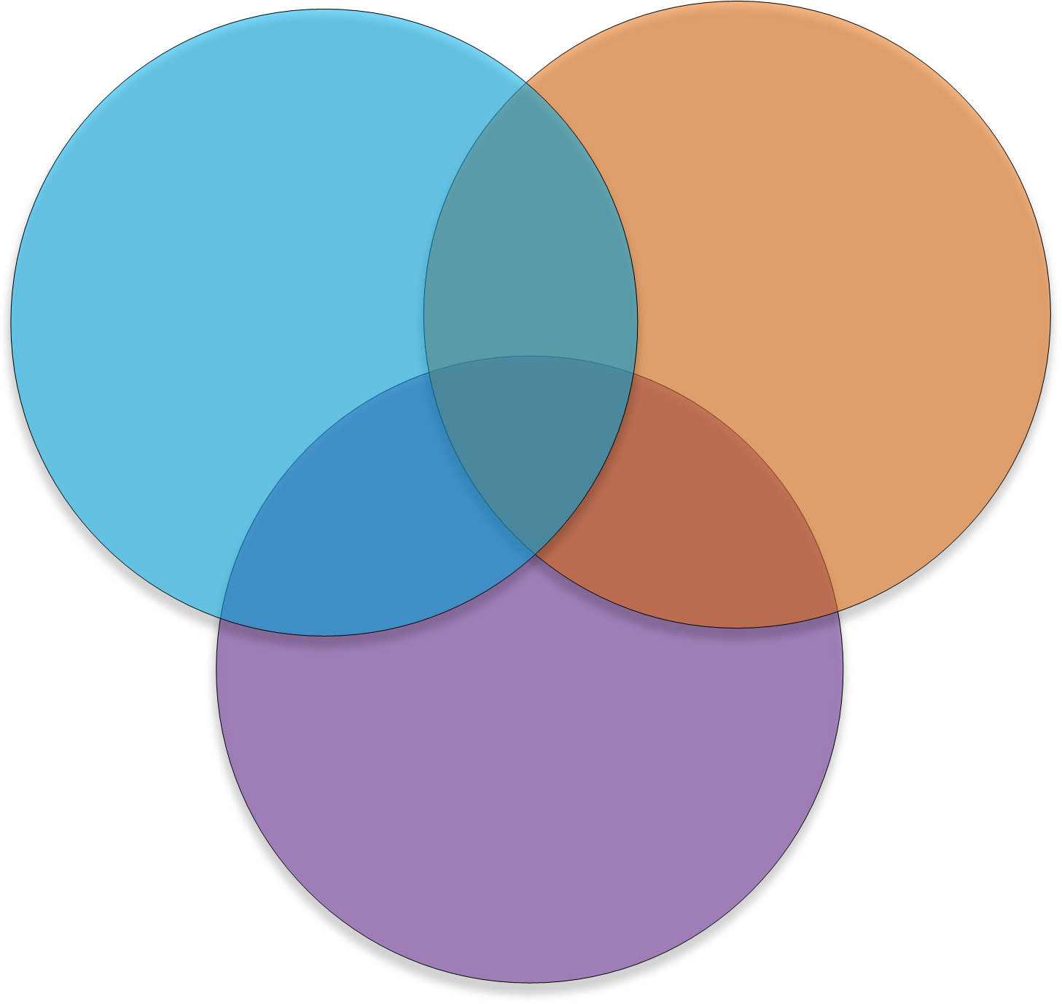
The ultimate teaching language?
Python
Java
Compilation
Procedural Programming
Static Types
OOP
Data Structures
Design Patterns
Interpreted
Dynamic Typing
REPL
C-Style
Functional Programming
JavaScript

Slide 13






Who Uses scala

Slide 14
Software written in scala

Slide 15


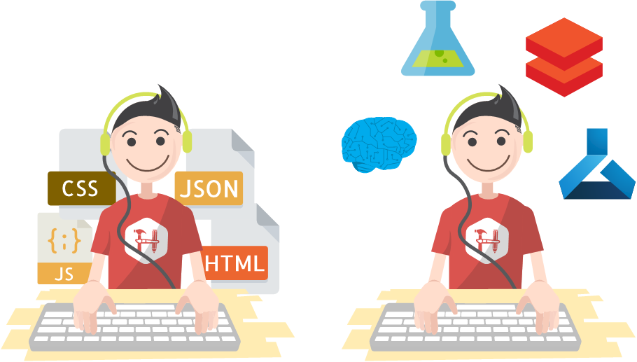
But still, why bother….
Notes:
Transferable, portable skills in their day job, Competitive skill set
Scala is multipurpose, meaning you can use if for anything from a simple web app to ML
It has a solid community behind it
It is Type safe
Learn Functional Programming

Slide 16
Types safety means you can’t turn a cat into a dog

Slide 17
Basics of Scala What are we going to look at?
Case Classes
Option
Pattern matching
Map & FlatMap
Reduce and Filter
For Comprehensions

Slide 18
Code demo’s

Slide 19
Case classes
Good for modelling immutable data Act like blueprints

Slide 20
Case classes

Slide 21
OPTIONS
Handles empty values without error

Slide 22
The NULL Mistake
“I call it my billion-dollar mistake. It was the invention of the null reference in 1965” — Tony Hoare, 2009

Slide 23
How does Scala handle Nulls: Options
A Scala Option holds zero or one element of a type. This means that it is either a Some[T] or a none object. One place we get an Option value is through the get() method for a Map
SOME = Something
NONE = Nothing

Slide 24
MAP
Opens the box of data and transforms it accordingly

Slide 26
FLATMAP
Opens the box of data, transforms it, and flattens it accordingly

Slide 27
When you forget to use flatmap

Slide 28
REDUCE AND FILTER
Sum everything up Only get the data you need

Slide 30
FOR COMPREHENSION
Monads

Slide 31
Functional Programming: Monads
Step One
A Monad is a sequence of events with a get out of jail card
Step Two
Step Three

Slide 32
Summary
Gone over some of the basics
Apply these when working with Scala in Databricks
Be able to understand Maven and Spark packages
Robustly test code
Create a portable Jar

Slide 33
Useful links
Learning
https://www.scala-exercises.org/
https://scala.epfl.ch/
https://www.coursera.org/specializations/scala
https://typelevel.org/cats/
https://medium.com/disney-streaming/tagged/thisweekinscala
Conferences
https://scaladays.org/
https://scala.world/

Slide 34
THANK YOU
https://github.com/AnnaWykes/taking-the-scary-out-of-scala
anna-maria-wykes-31939454
@annawykes

